Slide 1
Customer behavior using food delivery services in GCC: studying engagement using sentiment analysis during COVID-19
Uzair Umar (Computer Science Sophomore)
Mohammad Saleh Ahsan Sakir (Information Systems Junior)

Slide 2
Table of Contents
Introduction
Importance and Literature Review of food delivery services
Experimental Setup
Engagement Analysis
Data analysis and Interpretation
Our findings and Suggestions
Challenges
Future Research Opportunities

Slide 3
Importance and Literature Review of food delivery service
“consumer–company interactions in food delivery platforms differ largely from interaction in traditional restaurant visits” (Teichert and Correa,2020)
“The use of sentiment analysis does not only detect significant shifts in customer sentiment, but also allow to determine the main reasons for the sentiment changes.” (Ibrahim and Wang,2019)
Notes:
Lit reveiw on what?
Add another slide (what are we studying)

Slide 4














Experimental Setup
Platforms explored:
Twitter and Youtube
Tweepy and TwitterSearch packages
Youtube data API
Libraries Used:
Delivery services targeted:
Notes:
Diversity across platform

Slide 5
Engagement Analysis
Measuring Engagement
Sentiment Analysis
Sentiment analysis is the interpretation and classification of emotions (positive, negative and neutral) within text data using text analysis techniques
Cross Platform (Twitter vs Youtube)
Time perspective (before vs during COVID)
Measuring the correlation between likes, replies/retweets and client satisfaction
Notes:
How engagement is measured? (likes, replies/retweets, sentiment & correlation)
Tell what is sentiment analysis [I added the definition]

Slide 6
Data Preparation
Extraction
Twitter - tweets, likes, retweets
Youtube - comments, likes, replies
Structuring
Cleaning (filtering)
Irrelevant comments & tweets
Phone numbers
Digital short forms
Emojis
Remove website URLs
Languages other than English
Sentiment detection
Notes:
sentiment detection (textblob & bigram)

Slide 7
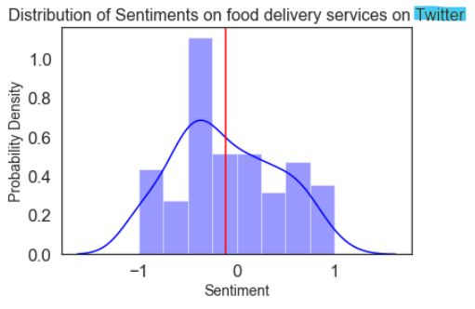
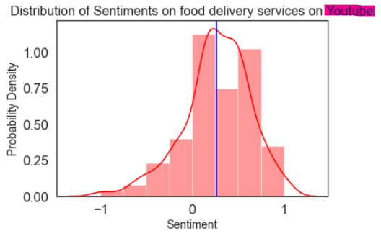
How sentiment varies between platforms?
Youtube is a recreational Platform
Twitter is a social interaction platform

Slide 8
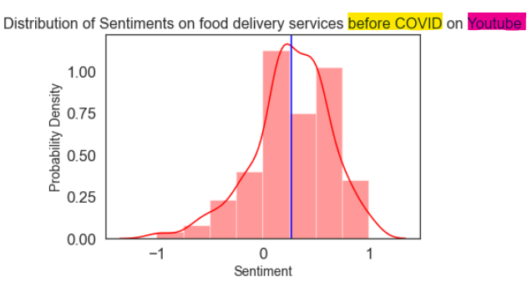
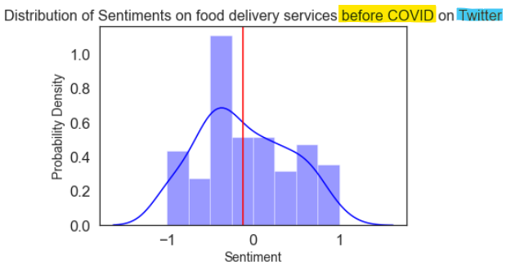
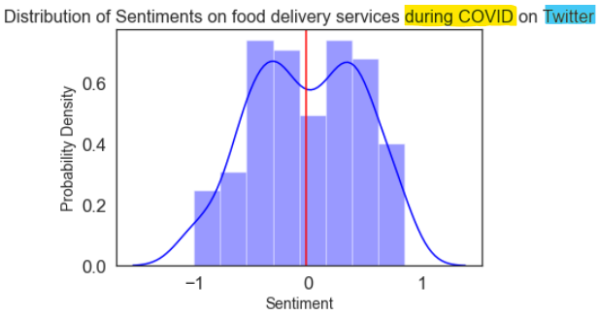
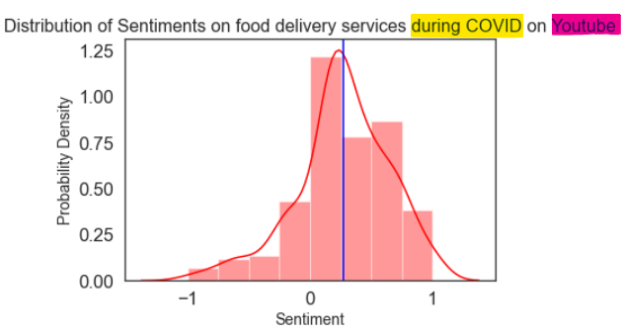
How sentiment changes over time?
Positive : Negative = 81:19 %
Positive : Negative = 80:20 %

Slide 9
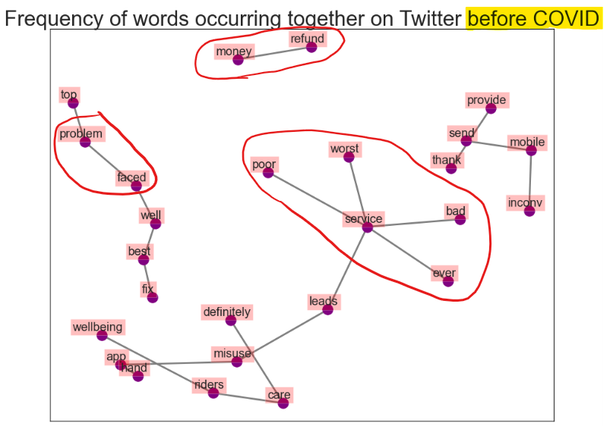
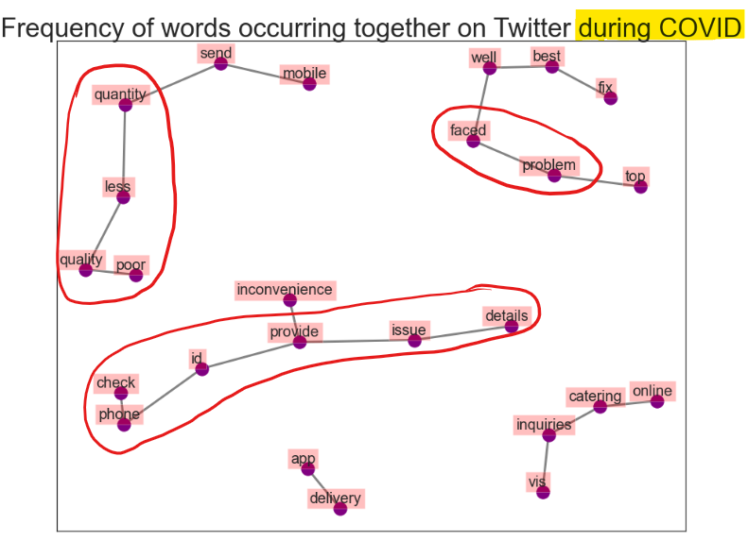
Why Sentiment changed over time?
Twitter Bigram
Companies Responding to customers
Twit pre
Yt pre
Notes:
Use bigram instead of co-occuring Frequency of occuring together

Slide 10
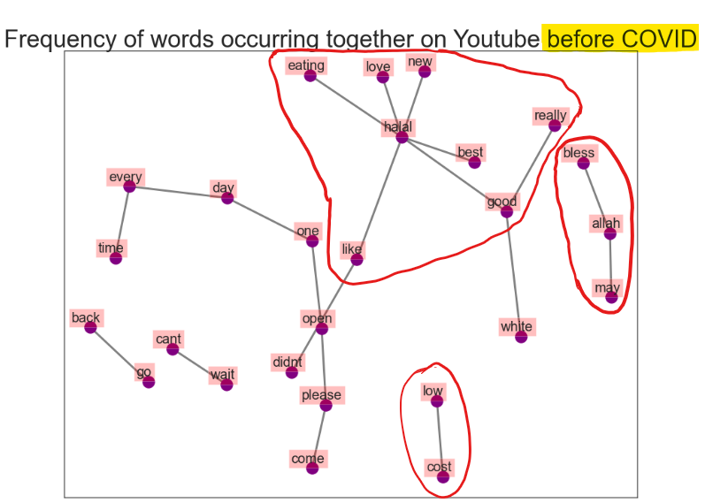
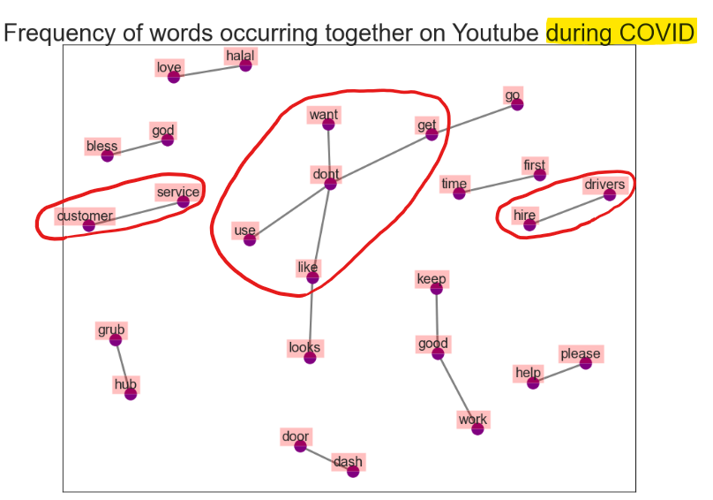
Youtube Bigram
Pathetic Customer Service
Rude Customer Service
Poor Customer Service

Slide 11
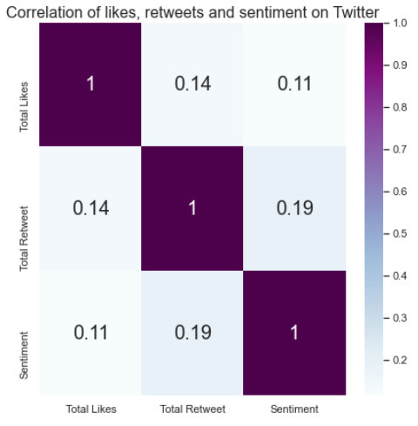
Can we determine sentiment from likes and retweets?
Twit Pre
Yt Pre

Slide 12
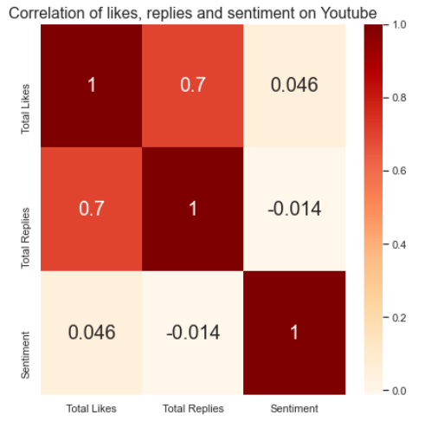
Can we determine sentiment from likes and replies?

Slide 13
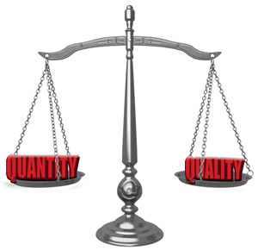



Findings
Suggestions
Reasons for sentiment change
Food delivery companies need to improve delivery timeliness. Restaurants need to improve food quality and food quantity
Food Quality, Quantity
Delivery Timeliness
Engagement is increasing on Youtube
Youtube can be used a marketing platform
Sentiment for twitter was mostly negative
Twitter can be used as a customer feedback platform
Notes:
Talk about the companies (Talabat, zomato etc.)

Slide 14
Challenges
Limited data available (API Restrictions)
No authorized access to both Facebook and Instagram
Arabic comments were not taken into consideration given the time constraint and complexity to translate them
Notes:
No other language was considered
Sticked to plain english texts only

Slide 15
Future Research Opportunities
Study of sentiment changes on a larger data set (including data from Facebook and Instagram)
Arabic sentiment changes to be taken into consideration
More data focused on during COVID scenario (months from July onward)

Slide 16
References
Ibrahim, N. F., & Wang, X. (2019). Decoding the sentiment dynamics of online retailing customers: Time series analysis of social media. Computers in Human Behavior, 96, 32-45. https://doi.org/10.1016/j.chb.2019.02.004
Teichert, T., Rezaei, S. and Correa, J.C. (2020), "Customers’ experiences of fast food delivery services: uncovering the semantic core benefits, actual and augmented product by text mining", British Food Journal, Vol. ahead-of-print No. ahead-of-print. https://doi.org/10.1108/BFJ-12-2019-0909

Slide 17



